Slide 1
Good Habits of a Programmer
Mack 2022
Notes:
Last updated: 11-7-2022

Slide 2


Make a list
Starter activity
Think about what you have learnt about programming in this unit.
Make a list of the good habits a programmer should adopt.
Notes:
Image source: https://pixabay.com/photos/woman-programming-glasses-reflect-3597101/

Slide 3
Good programming habits
Starter activity
Use meaningful identifiers
Write code that is easy for others to read and interpret
Test often
Break problems down into subroutines
Keep backups
Follow the naming conventions for the language
Avoid multiple entry and exit points within code blocks
Comment on code to make it clear what each part does
Keep a document of useful code snippets
Read the documentation

Slide 4

Lesson 7: Good Habits of a Programmer
Objectives
In this lesson, you will:
Determine the good habits of a programmer
Explore alternative approaches to programming solutions
Append to a CSV file

Slide 5
Using meaningful identifiers
Activity 1
Question .
You want to make a variable that holds the score for a game, but you name it bob. Will the program still work?
if monty == python:
bob = bob + 2

Slide 6
Using meaningful identifiers
Activity 1
Question .
You want to make a variable that holds the score for a game, but you name it bob. Will the program still work?
Answer .
Yes
if monty == python:
bob = bob + 2

Slide 7
Using meaningful identifiers
Activity 1
Question .
Why is it not a good idea to name a variable that holds the score bob?
if monty == python:
bob = bob + 2

Slide 8
Using meaningful identifiers
Activity 1
Question .
Why is it not a good idea to name a variable that holds the score bob?
Answers .
It makes the code difficult to read
You can lose track of what the variable does
if monty == python:
bob = bob + 2

Slide 9
Using meaningful identifiers
Activity 1
At the moment, it is pretty difficult to know the purpose of this code.
This is because meaningful identifiers have not been used.
if monty == python:
bob = bob + 2

Slide 10
Using meaningful identifiers
Activity 1
By changing the identifiers to something meaningful, the code becomes easier to understand.
if answer == correct_answer:
score = score + 2

Slide 11
Following naming conventions
Activity 1
Programming languages use naming conventions that are typically specified in their documentation.
This is to make the code easier to read and to keep consistency across programs.
LEVELSCORE = 5
levelScore = 5
LevelScore = 5
levelSCORE = 5
level_score = 5

Slide 12
Following naming conventions
Activity 1
Question .
Which of these variables has been declared using the correct Python conventions?
LEVELSCORE = 5
levelScore = 5
LevelScore = 5
levelSCORE = 5
level_score = 5
A
B
C
D
▹
E

Slide 13
Following naming conventions
Activity 1
Question .
Would the other variable names still work?
LEVELSCORE = 5
levelScore = 5
LevelScore = 5
levelSCORE = 5
level_score = 5
A
B
C
D
▹
E

Slide 14
Following naming conventions
Activity 1
Question .
Would the other variable names still work?
Answer .
Yes
LEVELSCORE = 5
levelScore = 5
LevelScore = 5
levelSCORE = 5
level_score = 5
A
B
C
D
▹
E

Slide 15
Test early, test often
Activity 1
Question .
Why is it good practice to test your code early and often?
file = open("weatherdata.csv", "r")
data = []
for line in file:
line = line.strip()
line = line.split(",")
data.append(line)
file.close()
datalength = len(data)
for x in range(1, datalength): # range ignores the header row
rainfall = data[x][5]
data[x][5] = float(rainfall)
highestrainfall = 0
for x in range(1, datalength): # range ignores the header row
if data[x][5] > highestrainfall:
highestrainfall = data[x][5]
timestamp = data[x][0]
print(f"Highest recorded rainfall: {highestrainfall} on {timestamp}")

Slide 16
Test early, test often
Activity 1
Answer .
Testing code early and often makes it easier for you to find and fix errors.
If you break your code, then you can easily go back a few steps to the last time it worked.
file = open("weatherdata.csv", "r")
data = []
for line in file:
line = line.strip()
line = line.split(",")
data.append(line)
file.close()
datalength = len(data)
for x in range(1, datalength): # range ignores the header row
rainfall = data[x][5]
data[x][5] = float(rainfall)
highestrainfall = 0
for x in range(1, datalength): # range ignores the header row
if data[x][5] > highestrainfall:
highestrainfall = data[x][5]
timestamp = data[x][0]
print(f"Highest recorded rainfall: {highestrainfall} on {timestamp}")

Slide 17

Start small
Activity 1
Problems can often feel too big to solve.
All programmers experience this at varying levels.
The trick is to start small and decompose the problem.
Notes:
Image source: https://pixabay.com/photos/puzzle-match-missing-hole-blank-693870/

Slide 18
Start small
Activity 1
Break a large problem down into smaller subproblems.
If the subproblem is still too challenging, break it down even further.
Notes:
Image source: https://pixabay.com/photos/puzzle-match-missing-hole-blank-693870/

Slide 19
Start small
Activity 1
For example, you are asked to create a ‘guess the number’ game that will:
Select a random number between 1 and 100
Allow for 5 guesses
Give feedback, like higher or lower
Tell the user if they won or lost
Reveal the number of guesses
Notes:
Image source: https://pixabay.com/photos/puzzle-match-missing-hole-blank-693870/

Slide 20
Start small
Activity 1
You might start by seeing if you can check if the guess is correct by writing some code.
Once this bit is working, you move onto the next small chunk.
guess = 10
number = 10
if guess == number:
print("You won!")
else:
print("You lost!")

Slide 21
Use commenting
Activity 1
Code should be clear and readable.
Adding comments can help to provide extra insight into what the code is doing.
# single line comment
''' multiple
line
comment '''

Slide 22
Use commenting
Activity 1
This doesn’t mean that you should comment on every single line of your code.
guess = 10 # a variable for the guess
number = 10 # a variable for the number
if guess == number: # check if guess matches number
print("You won!") # if it does print won
else: # otherwise
print("You lost!") # print they lost

Slide 23
Use commenting
Activity 1
A sensible amount to add clarity is helpful.
guess = 10
number = 10
# check if guess is correct
if guess == number:
print("You won!")
else:
print("You lost!")

Slide 24
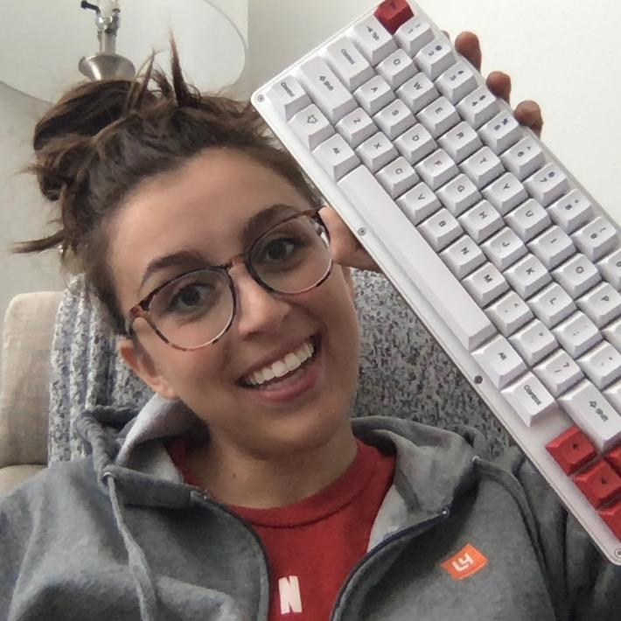
What do programmers say?
Activity 1
“Programming is all about continuing to try and learn even when it gets tough. There are so many times where I've been building a project, something stops working, and I have no clue why, and I have to figure out what went wrong. As you gain more experience, the major habit to build is to ask questions sooner rather than later.”
Cassidy Williams @cassidoo
Job title: Principal Developer Experience Engineer at Netlify
Notes:
Image and quote provided by Cassidy Williams with thanks.

Slide 25
What do programmers say?
Activity 1
“Programmers (like myself) have egos and we hate admitting that we don't know something, but the sooner you ask a question, the sooner your problem is solved and you move on.
Plus, you never know if your question is something that someone else needs answered, too. Ask questions, and share knowledge!”
Cassidy Williams @cassidoo
Job title: Principal Developer Experience Engineer at Netlify
Notes:
Image and quote provided by Cassidy Williams with thanks.

Slide 26

What do programmers say?
Activity 1
“Practice empathy for your users. Learn about the people using your product, try out the tasks they do and see how those experiences differ from yours. It’s motivating to understand how your work can affect people’s productivity and happiness”
Anna Lytical @theannalytical
Job title: Developer relations engineer by day and coding drag queen educator by night
Notes:
Image and quote provided by Anna Lytica with thanks.

Slide 27

What do programmers say?
Activity 1
For your personal journey
“Embrace change, keep challenging yourself to learn something new, read books on a new technique, try writing a basic program in a new language, or watch a talk about a new platform. There is a lot of change and great programmers embrace it.”
Emma-Ashley Liles
Job title: Senior Software Engineer at Kaluza
Notes:
Image and quote provided by Emma-Ashley Liles with thanks.

Slide 28
What do programmers say?
Activity 1
For working with others
“Try and become a better communicator every day. In your variable and function names, readme's, and git commits. Good programmers can communicate what the intent of their code is to other people.”
Emma-Ashley Liles
Job title: Senior Software Engineer at Kaluza
Notes:
Image and quote provided by Emma-Ashley Liles with thanks.

Slide 29
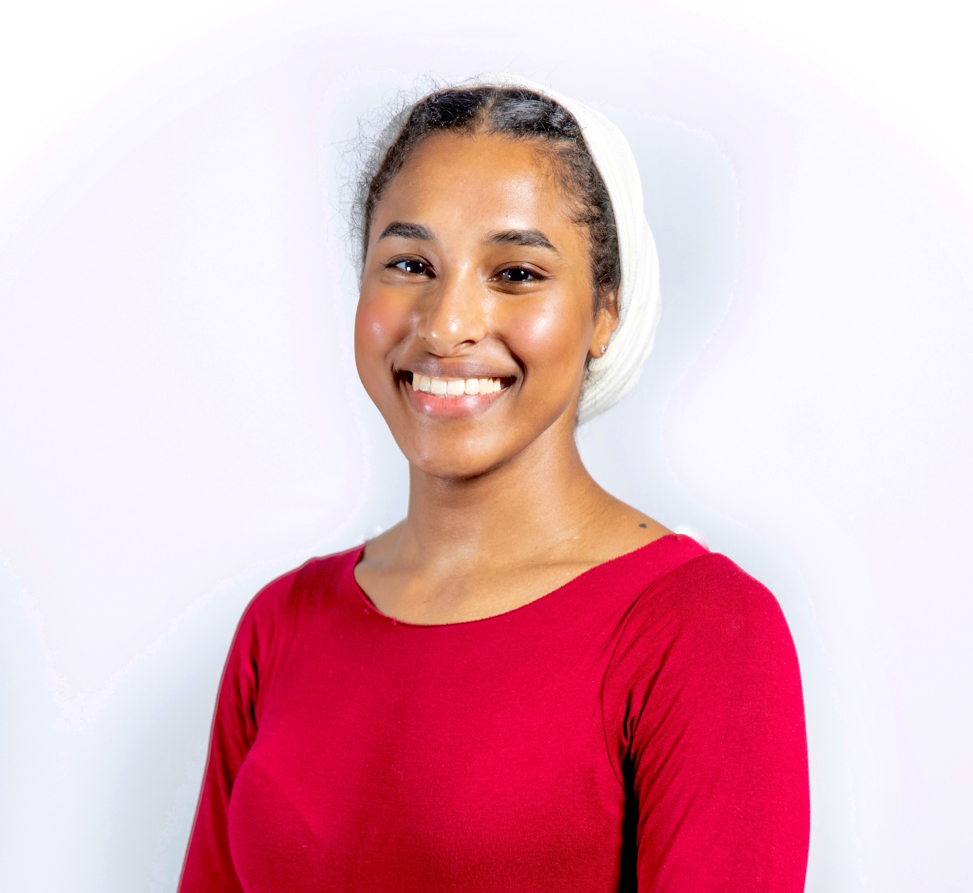
What do programmers say?
Activity 1
“Always make sure your code is accessible for anyone. This means that no matter what level of programming someone is at, they should be able to easily read and understand what you have done.
Don’t forget to include comments! They are helpful for understanding and explaining code steps, especially when starting out programming.”
Maimuna Ahmed
Job title: Software Engineer, Raspberry Pi Foundation
Notes:
Image and quote provided by Maimuna with thanks.

Slide 30
What do programmers say?
Activity 1
“Make sure you have relevant function and variable names, and not some random ones!
For example, if your function and variable relate to getting a book title, they should be named something like getBookTitle() and bookTitle — not foo or func!”
Maimuna Ahmed
Job title: Software Engineer, Raspberry Pi Foundation
Notes:
Image and quote provided by Maimuna with thanks.

Slide 31
What do programmers say?
Activity 1
“Simplify your code!
Separate big functions into other files and import/call them where needed.
Make sure the order of your code matches what it does in execution. This makes it easy to read and follow.
Cut down on your lines of code by optimising it.”
Maimuna Ahmed
Job title: Software Engineer, Raspberry Pi Foundation
Notes:
Image and quote provided by Maimuna with thanks.

Slide 32
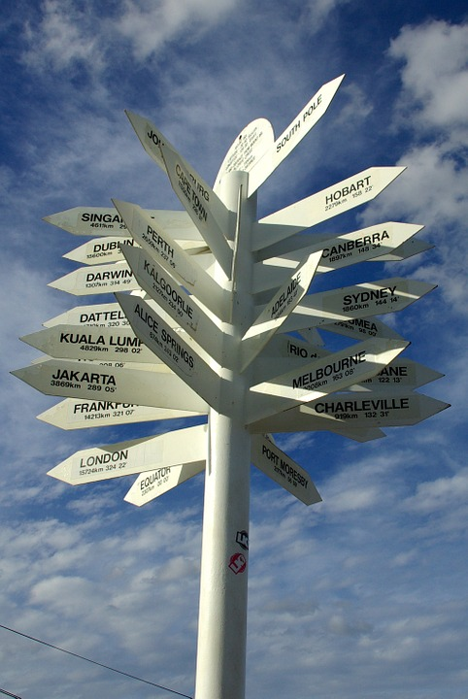
Code alternatives
Activity 2
When writing programs there are always plenty of ways to reach the final solution.
Taking the time to explore and experiment can make a real difference to your own skills and the solutions that you develop.
Notes:
Image source: https://pixabay.com/photos/signpost-direction-information-378569/

Slide 33
Code alternatives
Activity 2
During this unit, you have learnt quite specific ways to find solutions but there are always alternatives.
You will become more confident with using different approaches as your programming skills develop.
Notes:
Image source: https://pixabay.com/photos/signpost-direction-information-378569/

Slide 34
The input() function
Activity 2
During this unit, you have used the input() function in this way.
It is broken down into two steps:
Provide the instruction
Prompt for the input
1 2 | print("Enter your name:") name = input()

Slide 35
The input() function
Activity 2
You have learnt to do it this way because it allows you to see that there are two separate steps taking place.
1 2 | print("Enter your name:") name = input()

Slide 36
The input() function
Activity 2
There is an alternative approach.
You can pass the instruction as an argument.
1 | name = input("Enter your name:")

Slide 37
The input() function
Activity 2
When you execute this program, it will allow the user to type their name right next to the prompt.
1 | name = input("Enter your name: ")
Enter your name: Becky >>>

Slide 38
Incrementing a variable
Activity 2
This is how you have learnt to increment a variable in Python.
You have learnt it this way so that you can clearly see that you are adding a value to the value score.
1 2 | score = 4 score = score + 1

Slide 39
Incrementing a variable
Activity 2
This is an alternative approach.
1 2 | score = 4 score += 1

Slide 40
Incrementing a variable
Activity 2
Seeing this as a beginner programmer can be a little confusing, but as your confidence builds you find it is much easier to use this approach instead.
1 2 | score = 4 score += 1

Slide 41
Printing variables within string
Activity 2
You have been using f-strings to display variables within a string.
This is a really clean way to present variables, but there are alternative approaches that you might find helpful in some situations.
1 2 3 | name = "Python" score = 5 print(f"Name: {name} Score: {score}")

Slide 42
Printing variables within string
Activity 2
One approach is to use commas to separate the variables and the string.
1 2 3 | name = "Python" score = 5 print("Name:", name, "Score:", score)

Slide 43
Printing variables within string
Activity 2
You can also concatenate the string using a + sign.
This requires an extra step if any of your variables are not of the string data type.
1 2 3 | name = "Python" score = 5 print("Name: " + name + "Score: " + str(score))

Slide 44
Assigning vs direct calls
Activity 2
This program is designed to iterate through the list from the fourth item to the final item.
A separate variable has been used to hold the length of the list.
1 2 3 4 5 | numbers = [3, 4, 5, 2, 3, 4, 5, 5] numbers_length = len(numbers) for x in range(3, numbers_length): print(numbers[x])

Slide 45
Assigning vs direct calls
Activity 2
Again, this approach steps through the process for you making it easier to understand what the code is doing.
1 2 3 4 5 | numbers = [3, 4, 5, 2, 3, 4, 5, 5] numbers_length = len(numbers) for x in range(3, numbers_length): print(numbers[x])

Slide 46
Assigning vs direct calls
Activity 2
Here is an alternative approach.
There is no need to have a separate variable because len() can be called directly inside the parameters.
1 2 3 4 5 | numbers = [3, 4, 5, 2, 3, 4, 5, 5] for x in range(3, len(numbers)): print(numbers[x])

Slide 47
Assigning vs direct calls
Activity 2
By experimenting, you will find that you can use direct calls in many different contexts.
Sometimes that extra variable really isn’t necessary.
1 2 3 4 5 | numbers = [3, 4, 5, 2, 3, 4, 5, 5] for x in range(3, len(numbers)): print(numbers[x])

Slide 48
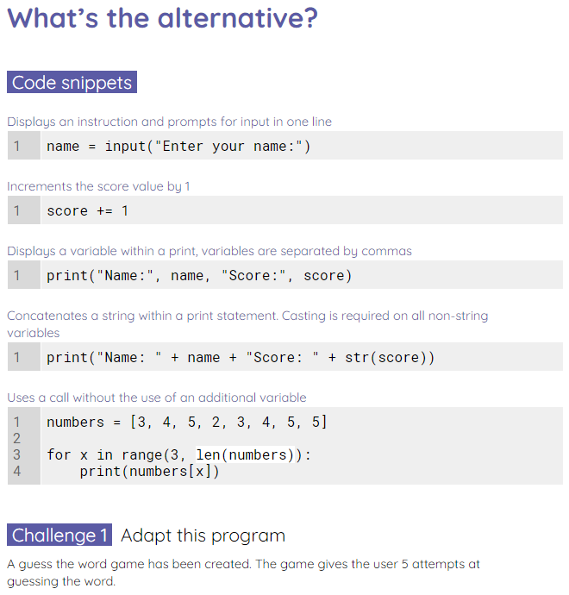
Explore alternatives
Activity 2
Use the worksheet to explore alternative approaches to programming.
You will also be required to fix any ‘bad habits’.

Slide 49
Appending to a CSV file
Activity 3
Last lesson you learnt how to write to a CSV file.
You will now see how to append to a CSV file and complete a programming challenge.

Slide 50
Appending to a CSV file
Activity 3
1 2 3 4 | file = open("numbers.csv", "a") numbers = "3,4,5" file.write(numbers) file.close()
Appending to a CSV file is just like appending to a standard text file.

Slide 51
Appending to a CSV file
Activity 3
1 2 3 4 | file = open("numbers.csv", "a") numbers = "3,4,5" file.write(numbers) file.close()
You just make sure that you use an a instead of a w for the mode.
Question .
Why is it important to open a file in the correct mode?

Slide 52
Appending to a CSV file
Activity 3
1 2 3 4 | file = open("numbers.csv", "a") numbers = "3,4,5" file.write(numbers) file.close()
Answer .
Opening the file in write mode will delete any existing file and replace it with a blank one.

Slide 53
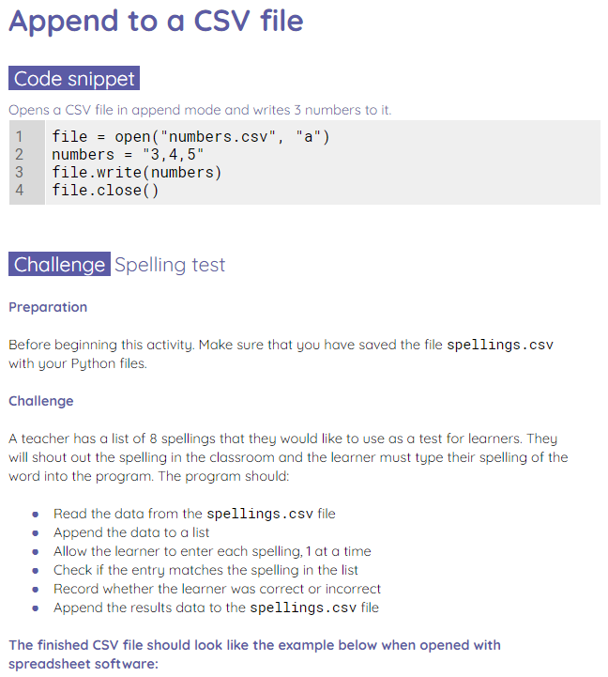

Appending to a CSV file
Activity 3
Use the worksheet to append to a CSV file.
Use any alternative approaches that you have learnt today in your solution.
Remember to comment your code!

Slide 54

Write a letter
Wrap
Write a letter to yourself in the past on your first day of this unit.
What advice or encouragement would you give yourself?
What is your top tip for getting the best out of this unit?
Notes:
Image source: https://pixabay.com/photos/still-life-school-retro-ink-table-851328/

Slide 55
Next lesson
Summary
In this lesson, you…
Learnt how to adopt good habits when programming
Learnt how to use alternative code for the same problem
Appended a CSV file with new data
Next lesson, you will…
Begin the final project where you will design and make a battle boats game

